Slide 1
Proposal Presentation
Matting based on Bayesian algorithm
Lingyu Gong, Changhong Li, Qiwen Tan
E3 School
Date 15/02/2024

Slide 2
Content
Group Introduction(Tan )
Mathematical Algorithm(Tan )
Function Blocks(Gong)
Testing Plan(Gong)
Flow of Implementation(Changhong)
Milestones and timeline(Changhong)

Slide 3
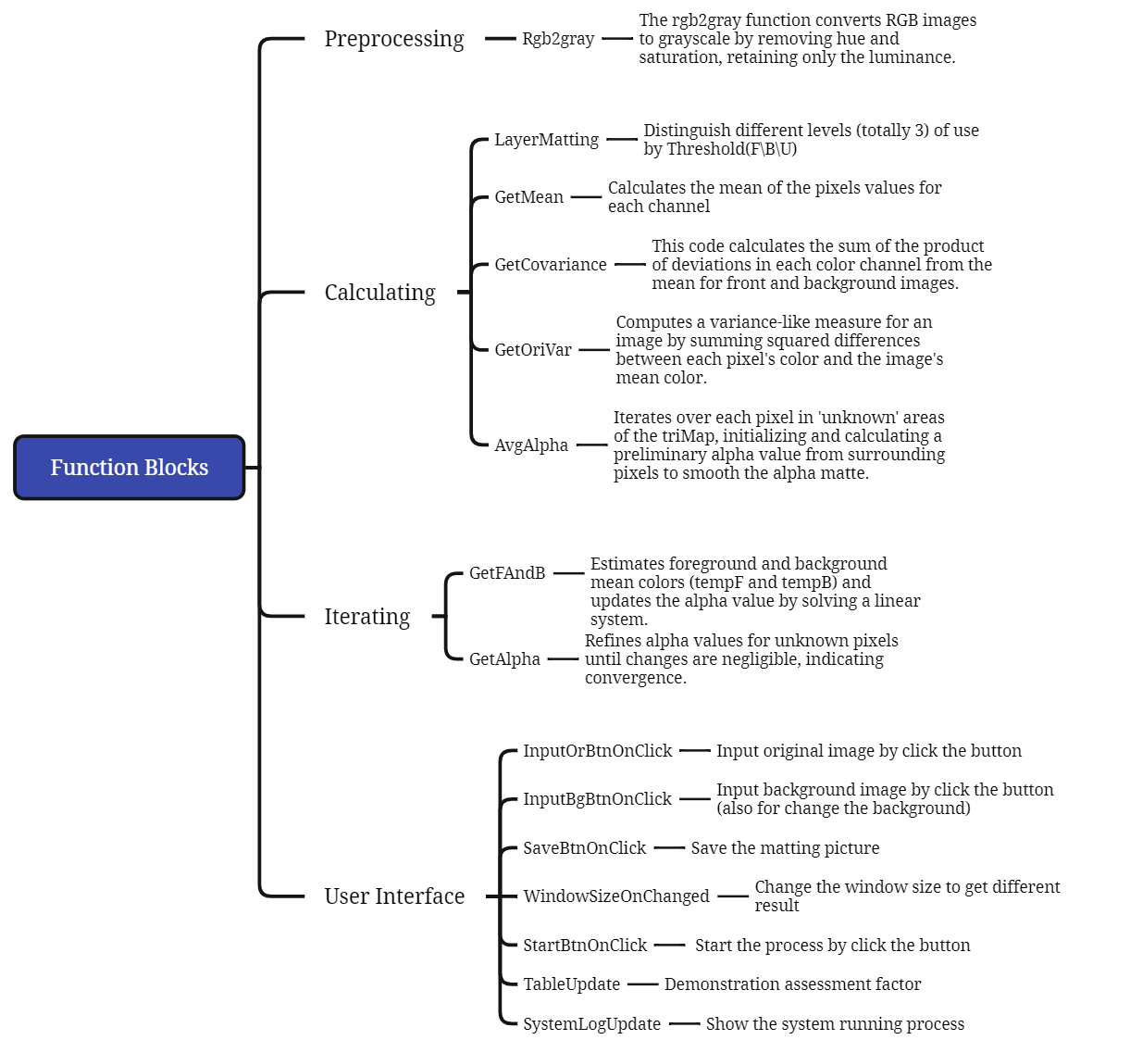
Function Blocks

Slide 4
Group Introduction
The development of Network-on-Chip

Slide 5
Copy paste fonts Choose the only option to retain text Adjust the spacing to adapt to Chinese typesetting
Supporting text here.
Text here
Text here
Text here
Theme color makes PPT more convenient to change.
Theme color makes PPT more convenient to change.
Theme color makes PPT more convenient to change.
Text here
Text here
Theme color makes PPT more convenient to change.
Theme color makes PPT more convenient to change.
Text here
….
Text here
….
Notes:
029030dc-a7b8-4b08-84f7-8538096bc74a.source.5.zh-Hans

Slide 6
Thank You

